Slide 1
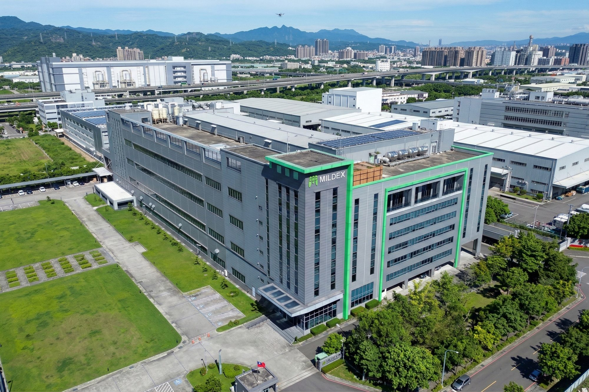

COMPANY PRESENTATION · 2025
Mildex Optical Inc.
End-to-End Touch Display & HMI Solutions
2025
mildexoptical.us

Slide 2
WHO WE ARE
Leading-Edge Touch Display Solutions
Mildex Optical Inc. is a global leading-edge designer and manufacturer specializing in advanced touch screen technologies for demanding applications. Publicly traded on the Taiwan Stock Exchange (TSE), Mildex brings end-to-end engineering, manufacturing, and integration capabilities to customers across defense, aerospace, medical, industrial, and commercial markets.
IATF 16949
ISO 9001
Automotive Quality
Quality Mgmt
Mildex Optical Inc. — Tempe, AZ · HQ Kaohsiung, Taiwan
TSE Listed
450+
Taiwan Stock Exchange
Engineers Worldwide
2

Slide 3
PART OF THE PANJIT GROUP
Global Scale. Local Expertise.
1986
6,700+
9
322K
FOUNDED
EMPLOYEES
MANUFACTURING
SQ FT
Kaohsiung, Taiwan
Worldwide
Facilities
New HQ Facility
Mildex Optical is a proud member of PanJit International — a global technology group with manufacturing in Taiwan, China, and Southeast Asia.
3

Slide 4

03
INDUSTRIES
& MARKETS
Proven across six demanding verticals

Slide 5
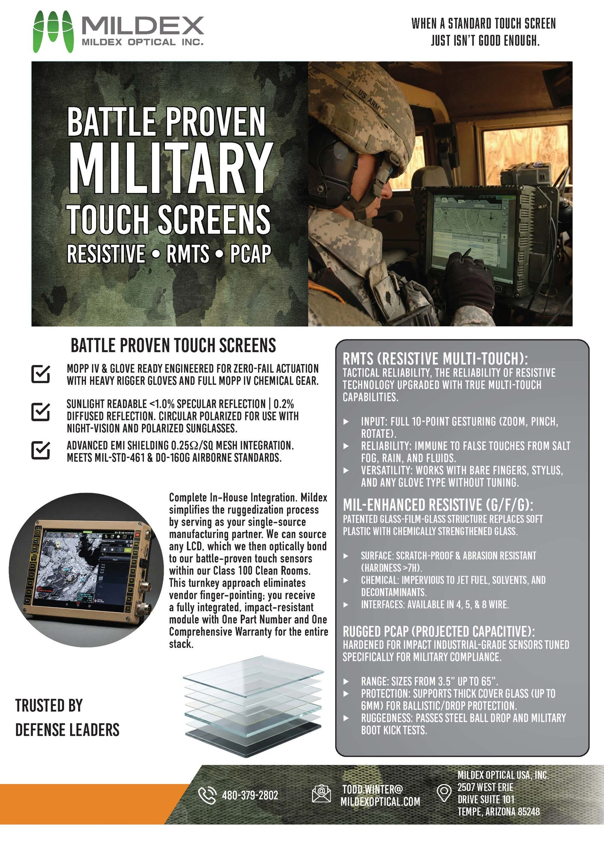
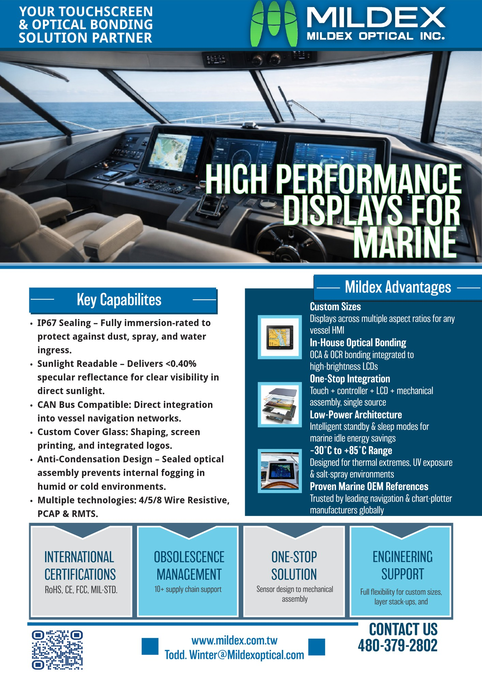
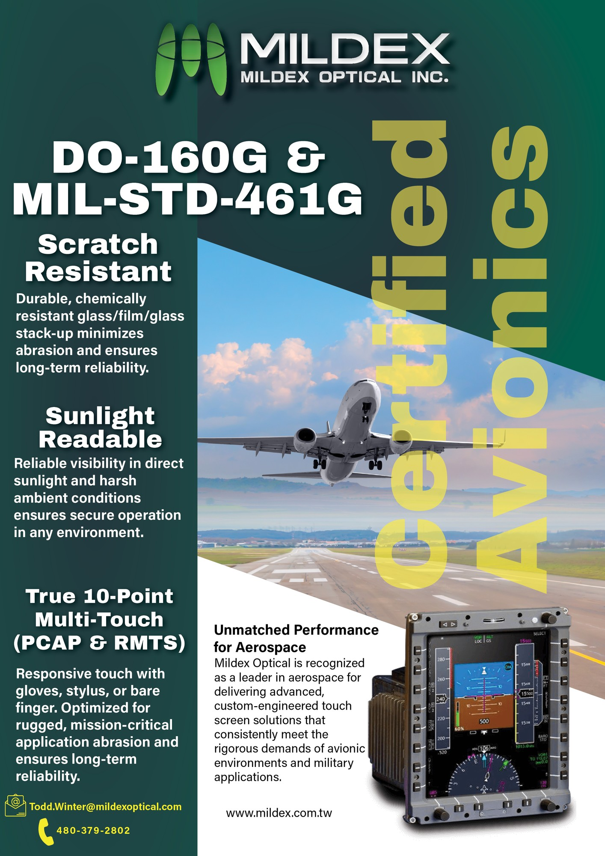



GLOBAL INDUSTRIES
Markets We Serve
Defense
Naval
Aerospace
MILITARY
MARINE
AVIONICS
Energy
Healthcare
Vehicle
OIL & GAS
MEDICAL
OFF-ROAD
5

Slide 6
PRODUCT MIX
Application Overview
65%
Projective Capacitive (PCAP)
Multi-touch, high-precision
35%
Resistive Technologies
65%
4W, 5W, 8W, and multi-touch
4.3"–65"
Display Size Range
Custom dimensions available
450+
Active Engineers
PCAP (65%)
R&D and manufacturing combined
Resistive (35%)
6

Slide 7
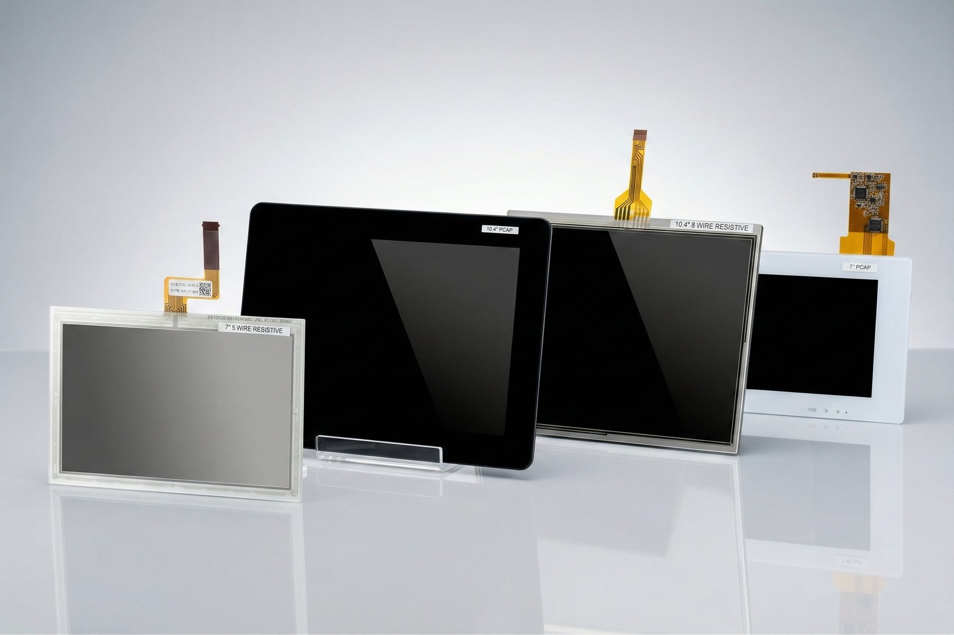
04
TOUCH
TECHNOLOGY
PORTFOLIO
PCAP · Resistive · RMTS · Display Enhancements

Slide 8

TOUCH TECHNOLOGY
PCAP Touch Screens
Touch Points
10-point multi-touch
Diagonal Size
4.3" to 65" (custom available)
Cover Glass
0.55mm to 6mm, chemically strengthened
ITO / Metal Mesh
Both sensor technologies available
Operating Temp
-40°C to +85°C
Ingress Protection
IP65 / IP67 rated
Certifications
MIL-STD-461, MIL-STD-810

Slide 9
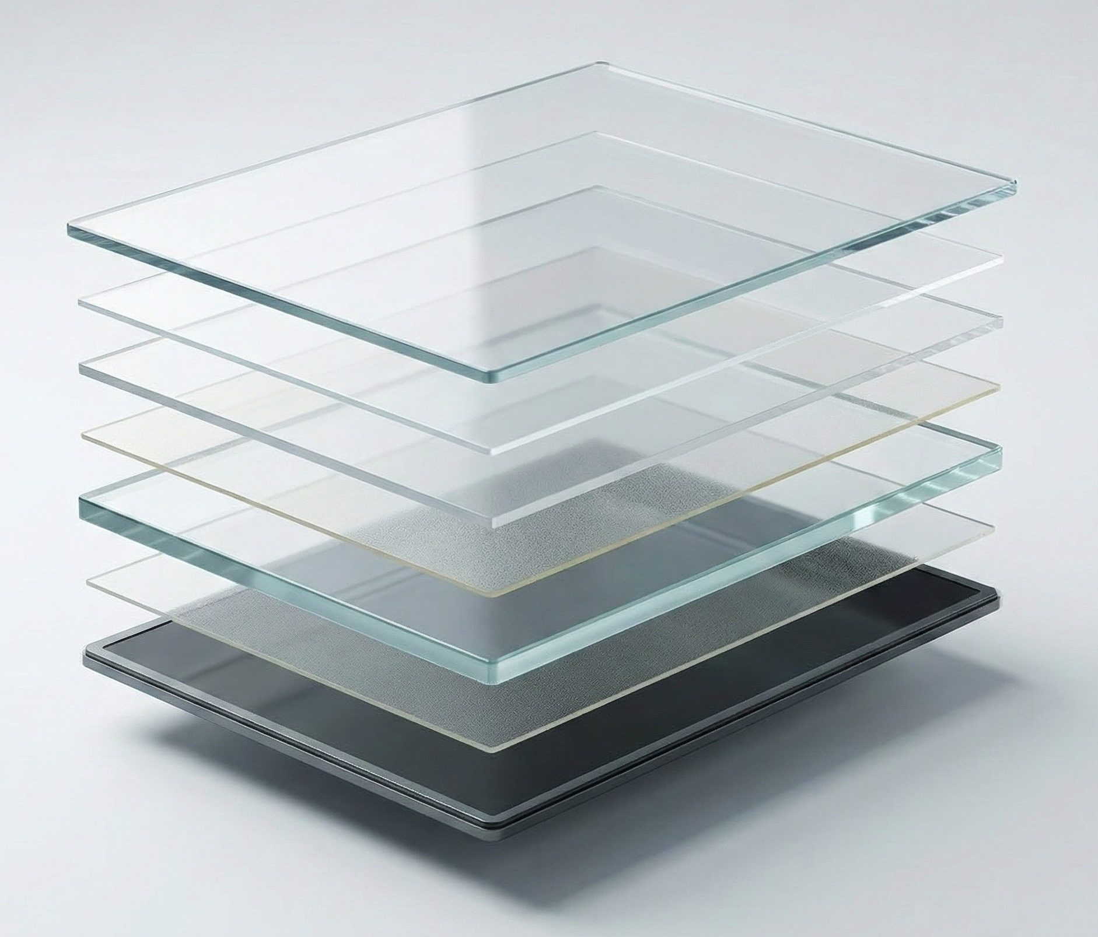
TOUCH TECHNOLOGY
Resistive Touch Screens
Types
4-Wire, 5-Wire, 8-Wire
Diagonal Size
3.5" to 21.5"
Input Method
Finger, stylus, glove, pen
Surface Hardness
3H standard, 7H GFG option
Operating Temp
-40°C to +85°C
Linearity
< 1.5% (5W), < 1.0% (8W)
Durability
35M+ actuations

Slide 10
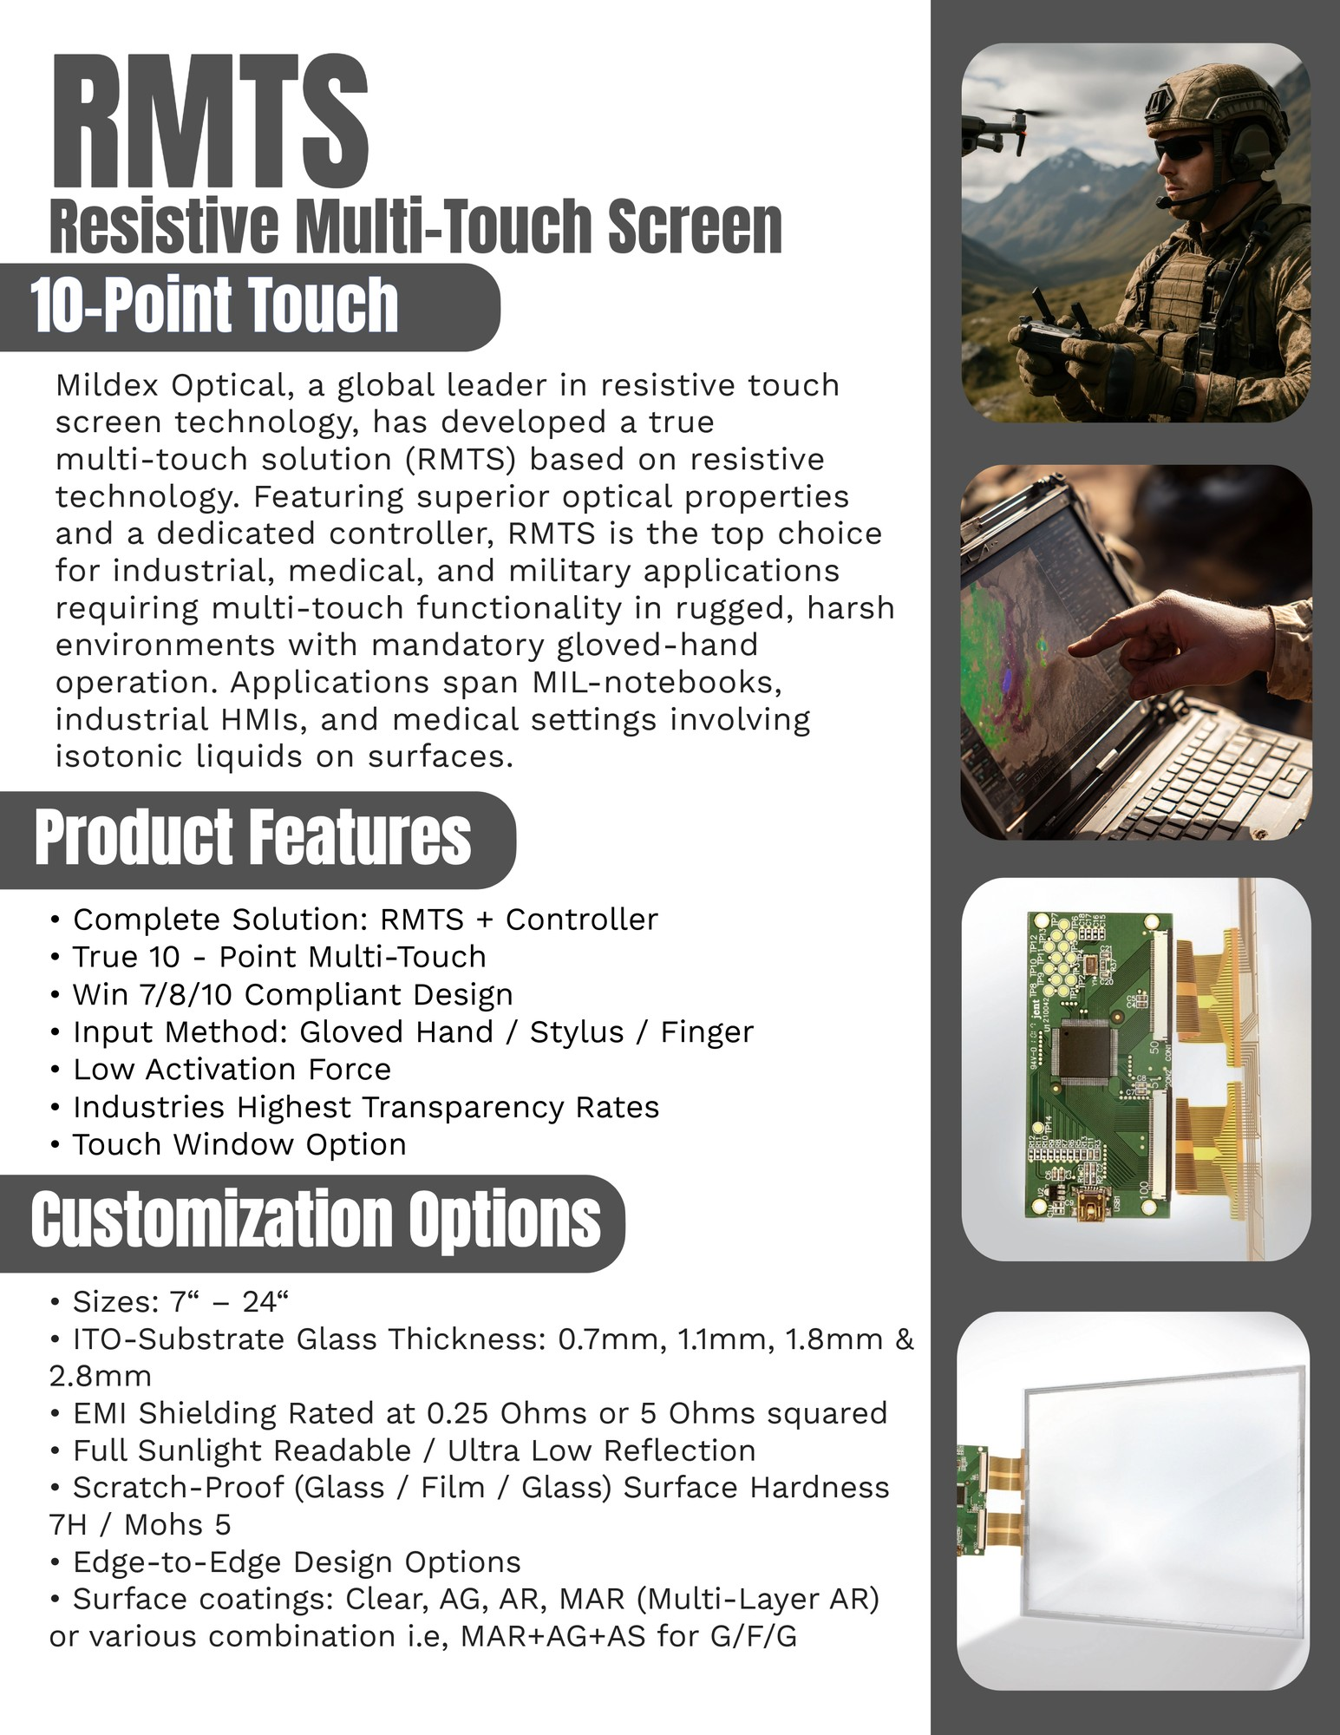
TOUCH TECHNOLOGY
Resistive Multi-Touch (RMTS)
Touch Points
2 to 10-point multi-touch
Diagonal Size
7" to 21.5"
Input Method
Finger, glove, stylus, pen
Controller
Integrated USB / RS-232 / I²C
Operating Temp
-40°C to +85°C
OS Support
Windows, Linux, Android
Certifications
MIL-STD-461E, CE, FCC

Slide 11
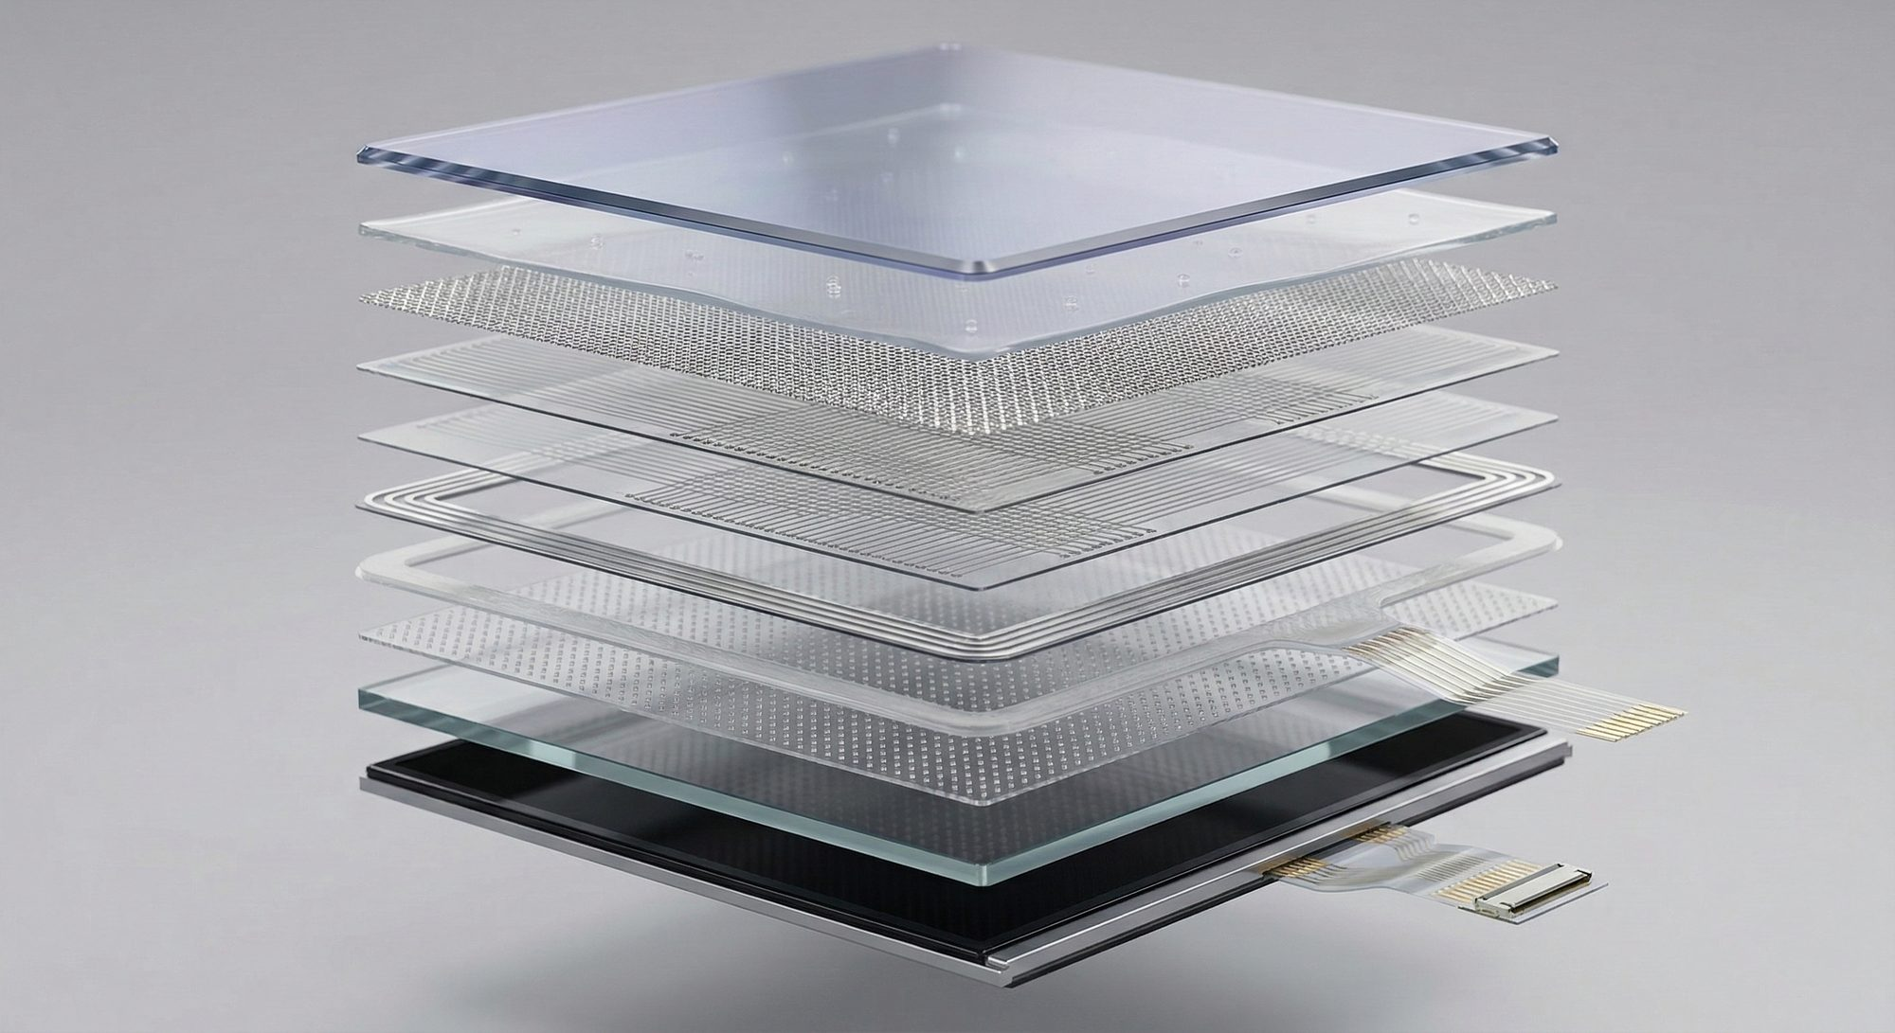

DISPLAY ENHANCEMENTS
Glass Film Glass · Sunlight Readable
Glass Film Glass (GFG)
Sunlight Readable
• 0.21mm top micro-glass layer
• Scratch-proof 7H surface hardness
• Eliminates pillow effect at high temps
• Transmission up to 80%
• Chemical resistant · All coatings possible
• Specular reflection < 1.0%
• Diffuse reflection < 0.2%
• Transmission > 77%
• MIL-810 approved solution
• Sizes up to 21.5" · EMI rated 0.25Ω/sq
11

Slide 12
CUSTOMIZATION
Custom Enhancements & Solutions
Optical Enhancements
Mechanical Enhancements
• Ultra-Low-Reflection coatings
• Surface coatings: MAR · AR · AG · AS
• Anti-UV protection layers
• High-transmission treatments
• Glass Film Glass (GFG) stackup
• Optical bonding integration
• Spacer-dot arrangements
• Edge strengthening & shaping
Integration Designs
Electrical Enhancements
• True-flat / Bezel-less windows
• Custom PCB & controller design
• Full HMI assembly
• Rugged sealed enclosures
• EMI shielding < 0.25 Ω/sq
• Grounding / conductive tape
• USB · I²C · RS232 interfaces
• Windows · Linux · Android drivers
12

Slide 13
05
OPTICAL
BONDING &
INTEGRATION
OCR bonding · Zero air gap · Full-module warranty

Slide 14
OPTICAL BONDING
Why Optical Bonding?
Improved Readability
Enhanced Durability
Eliminates internal reflections — up to 4× better contrast in direct sunlight.
OCR layer absorbs shock and vibration — passes MIL-STD-810G boot kick test.
Moisture Elimination
Thinner Profile
No air gap means no condensation, fogging, or contamination between layers.
Removal of air gap allows for slimmer, lighter form-factor assemblies.
Full Module Warranty
Wide Temperature Range
Mildex warranties the complete bonded assembly — touch sensor + LCD + bond.
Qualified to -40°C to +85°C for harsh environments including military applications.
14

Slide 15
OPTICAL BONDING
Optical Bonding vs. Air Bonding
Attribute
Optical Bonding
Air Bonding
Bonding Material
OCR (Optical Clear Resin)
DST (Double-Sided Tape)
Total Reflection
< 6%
> 12%
Reflection Contrast
> 8:1
< 1:1
Outdoor Readability
Excellent
Poor
Shock / Vibration
Excellent — bonded layer
Poor — air gap absorbs none
Condensation Risk
None — no air gap
High — moisture in gap
Impact Resistance
Passes MIL boot kick test
Fails
Warranty
Full module inc. LCD
Touch only
15

Slide 16
THE MILDEX ADVANTAGE
Why Choose Mildex?
01
02
03
Reliability
Engineering
Speed
• 20+ years touch & display expertise
• Long-term product availability
• Full warranty on complete modules
• IATF 16949 · ISO 9001 quality processes
• Lowest NRE fees in the industry
• Short design cycles
• Custom designs from 4.3" – 65"
• Single partner from concept to production
• Vertically integrated manufacturing
• Strong project monitoring
• On-time delivery programs
• Bonded inventory options available
16

Slide 17
Let's Connect
Contact your local sales representative
or reach out to our team directly.
WEBSITE
mildexoptical.us
EMAIL
tiffany.touch@mildexoptical.us
ADDRESS
2507 W. Erie Dr. Suite 101
Tempe, AZ 85282
Proudly Designed & Manufactured in Taiwan

